Slide 1



THE EFFECTIVENESS OF ULTRAVIOLET LIGHTS IN DISINFECTING
USING AN AUTOMATIC DISINFECTION BOX
IMPLEMENTED WITH ARDUINO
Bagas, John Christopher B.
Guerrero, Charles Adriane S.
Saralde, Marcus M.
Pabanil, Michael John P.
Engr. Pedrito Tenerife Jr.
Computer Engineering Practice and Design 1

Slide 2

Introduction
Problem: Pandemic, demand in disinfecting materials.
Propose solution: The effectiveness of ultraviolet lights in disinfecting using an automatic disinfection box Implemented with Arduino
4609
POLYTECHNIC UNIVERSITY OF THE PHILIPPINES

Slide 3
Statement of the Problem
1. What is the significant difference between uv-based disinfectant and alcohol-based disinfectant in terms of their effectiveness?
2. Is there a significant effect among the different factors listed below in terms of its effectiveness?
Intensity of ultraviolet to be used
Duration time to ultraviolet light exposure
3. How efficient the automatic disinfection box in terms of:
Production cost
Conveniency
4609
POLYTECHNIC UNIVERSITY OF THE PHILIPPINES

Slide 4
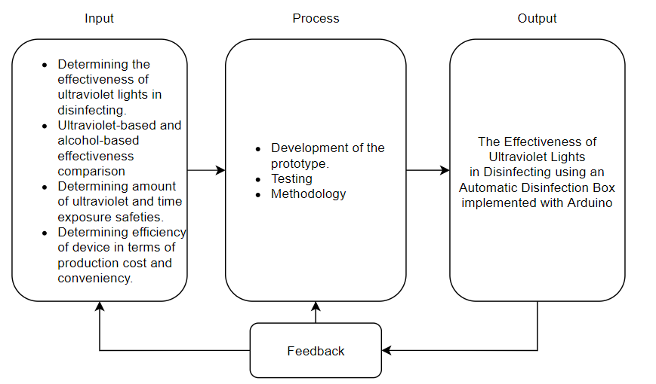
Research Paradigm
4609
POLYTECHNIC UNIVERSITY OF THE PHILIPPINES

Slide 5
Significance of the Study
1. To health and safety officers - Automated disinfection promotes contactless, safe and good social distancing practice.
2. To the user – Contactless disinfection.
3. To the environment – Less plastic waste residue. reusable.
4. To the future researchers - Serves as good foundation of contactless. automatic and innovative method of disinfection.
4609
POLYTECHNIC UNIVERSITY OF THE PHILIPPINES

Slide 6
Scope and Limitations
130L, 100W, 154H cm
Determining significant difference between ultraviolet-based and alcohol based (70% alcohol content, isopropyl) disinfection
Determining significant effect in effectiveness in the amount of ultraviolet to be used (222nm, 254nm UVC), time of ultraviolet exposure.
Determining efficiency of the automatic disinfection box implemented with Arduino in terms of production cost and conveniency.
4609
POLYTECHNIC UNIVERSITY OF THE PHILIPPINES

Slide 7
Scope and Limitations
Determining the significant difference of uv-based disinfection and specific brands of alcohol.
4609
POLYTECHNIC UNIVERSITY OF THE PHILIPPINES

Slide 8
Research Design
Quantitative experimental research design: for SOP 1-3a
Qualitative research design: for SOP 3b
Method of analysis
T-test
One sample t-test
ANOVA
Likert scale
Tools and methods
4609
POLYTECHNIC UNIVERSITY OF THE PHILIPPINES

Slide 9
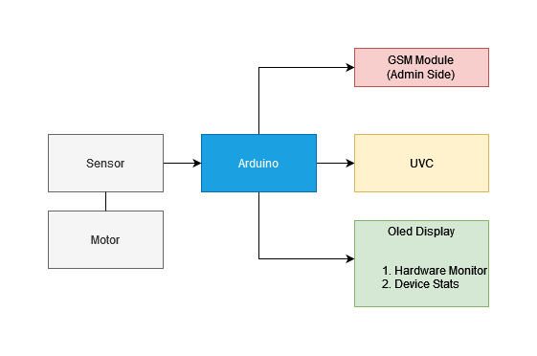
Diagrams
Figure 1: Block diagram
4609
POLYTECHNIC UNIVERSITY OF THE PHILIPPINES

Slide 10
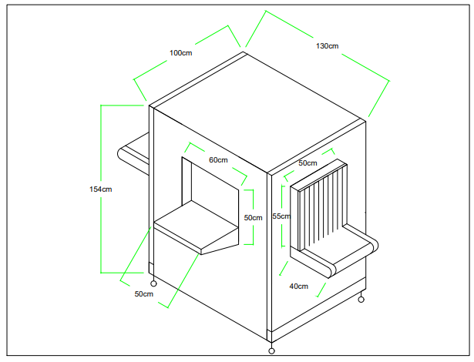
Diagrams
Figure 2: Prototype Design
4609
POLYTECHNIC UNIVERSITY OF THE PHILIPPINES

Slide 11
List of Materials
Arduino
UVC
Resistor
PIR sensor
LED display
GSM module
Motor
Wire
Power supply
PCB
4609
POLYTECHNIC UNIVERSITY OF THE PHILIPPINES

Slide 12
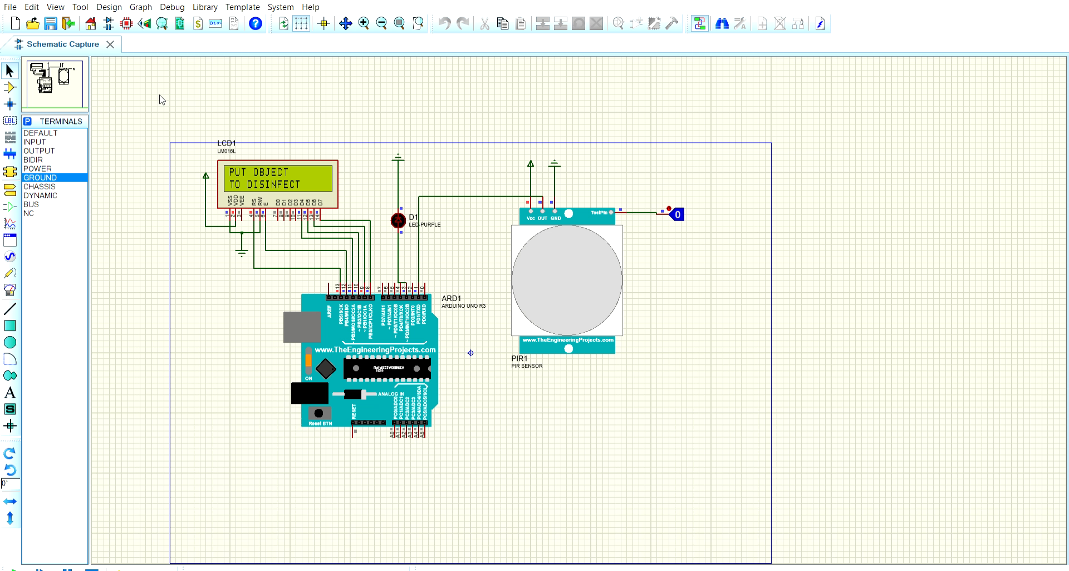
Circuit Simulation
4609
POLYTECHNIC UNIVERSITY OF THE PHILIPPINES

